Slide 1
The US National Primate Research Centers Program
Andrew A. Lackner, DVM, PhD
Tulane National Primate Research Center
Tulane University Health Sciences
Notes:
--Overview of US National Primate Research Program
capabilities
operations
Synergies/interaction with other NIH research infrastructure
--International collaborations
--Opportunities and obstacles for enhanced international collaborations

Slide 2
NPRC Overview (I)
Network of 8 nonhuman primate biomedical research and resource centers
Each NPRC is a national resource
Provides access to >26,000 nonhuman primates
73% are rhesus macaques (19,000) and predominantly Indian origin
Baboons (2,300)
other macaques (2,600)
New world monkeys (900)
Chimpanzees (250)
Notes:
Conceptually each NPRC is a small academic research hospital

Slide 3
NPRC Overview (II)
Support many scientific disciplines, including models for most major human diseases
Provides the necessary specialized facilities, personnel and equipment to support NIH research
Core Scientists (approximately 300)
BSL2, BSL3 and BSL4 laboratories and animal space
Provides infrastructure support for more than 2,000 scientists, funded by more than 1,500 NIH grants, totaling nearly $1 billion/year
Perform both independent and collaborative multi-categorical research programs
Training
Notes:
Conceptually each NPRC is a small academic research hospital

Slide 4
Mission To improve human and animal health through basic and applied biomedical research
Conduct basic and applied biomedical research on human health problems that require the use of nonhuman primates
Investigate nonhuman primate biology and diseases particularly with regard to the study of human health problems
Serve national resources and centers of excellence for biomedical research using nonhuman primates
Provide training for graduate students, veterinarians, postdoctoral fellows, undergraduates and visiting scientists
Educate the general public about the critical link between research with animal models and improvements in human health

Slide 5
Washington NPRC
Seattle, WA
Wisconsin NPRC
Madison, WI
New England NPRC
Southborough, MA
Oregon NPRC
Beaverton, OR
Yerkes NPRC
Atlanta, GA
California NPRC
Davis, CA
Southwest NPRC
San Antonio, TX
Tulane NPRC
Covington, LA

Slide 6
NPRC Services and Capabilities

Slide 7
Veterinary Services
Animal husbandry and resource management
Clinical medicine and surgery
Research support (service)
Collaborative and Independent research
Model development and refinement
Regulatory compliance
Animal welfare Act--USDA
Public Health Service/NIH--OLAW
AAALAC International
Environmental Enrichment program
Biosafety
Training

Slide 8
Integrated clinical and laboratory support for NHP biomedical related research Clinical capabilities
Full time staff of veterinarians, pathologists and technicians. Examples of technical capabilities include:
Bronchoscopy and bronchoalveolar lavage
Minimally invasive surgery, endoscopy and endoscopic biopsies
Fluid collection (saliva, urine, CSF, bronchoalveolar lavage)
Noninvasive imaging (Ultrasonography, Radiography, CT, MRI, PET)
Radiotelemetry for remote physiologic monitoring

Slide 9
Integrated clinical and laboratory support for NHP biomedical related research Laboratory capabilities
Assisted Reproductive Technologies
Anatomic and Clinical Pathology
Bioengineering
Confocal Microscopy and Image Analysis
Diagnostic Parasitology
DNA Microarray and Expression
Environmental and Infectious Disease Aerobiology
Flow Cytometry and Cellular Immunology
Genetics, Genomics and Genome Banking
Molecular Pathology
Protein production and purification
Proteomics
Nonhuman Primate Stem Cell Production
Pathogen Detection and Quantification
Vector Borne Diseases (insectaries)
Vector Development and Production
Viral Characterization, Isolation and Production

Slide 10
NHPRC Consortium
Participants/organization
Eight National Primate Research Centers (NPRCs)
Additional NHP institutions – Caribbean PRC, Wake Forest, MD Anderson, more to follow
Working groups established in the areas of Breeding colony management, Genetics, DNA banking, Behavioral management, Pathology and Training
Goals:
Strengthen communications
Leverage system-wide resources
Facilitate sharing of information, tools and best practices
Support cross-center collaborations
Establish a common data-sharing infrastructure – Biomedical Informatics Research Network (BIRN)

Slide 11
Consortium Project Summary
In production
BIRN infrastructure
NHPRC consortium website – supporting the six working groups
National NHP DNA bank
Available animal locator – animal level data (3 centers)
Current priorities
Available animal data acquisition process for remaining centers
Pathology image database
SNP LIMS database evaluation
Genetics tool portal
Expansion of website resources for all working groups
Animal Resource Management Tools deployment

Slide 12
Synergies with other NIH programs
BIRN: Biomedical Informatics Research Network
http://www.ncrr.nih.gov/informatics_support/biomedical_informatics_research_network/
Clinical and Translational Science Centers
http://www.ncrr.nih.gov/clinical_research_resources/clinical_and_translational_science_awards/index.asp
Center for HIV-AIDS Vaccine Immunology (CHAVI)
https://chavi.org/
Centers for AIDS Research
http://www.niaid.nih.gov/labsandresources/resources/cfar/Pages/default.aspx
HIV Vaccine Research and Development
http://www.niaid.nih.gov/topics/HIVAIDS/Research/vaccines/funding/Pages/HIVRADabstracts.aspx
Regional Centers of Excellence in Biodefense and Emerging Infections
http://www.niaid.nih.gov/labsandresources/resources/rce/Pages/default.aspx

Slide 13
AIDS
Discovery of SIV
Direct demonstration that AIDS is caused by a virus
Origins of HIV from cross species transmission from African nonhuman primates
Demonstration that a vaccine is feasible
First pathogenic molecular clone
Demonstration that the gut is the primary site of early virus replication
Testing ground for vaccine and microbicide concepts and products prior to human testing
Notes:
Selected examples of NPRC contributions
infectious diseseas
AIDS
other
Stem cell biology and reproductive technologies

Slide 14
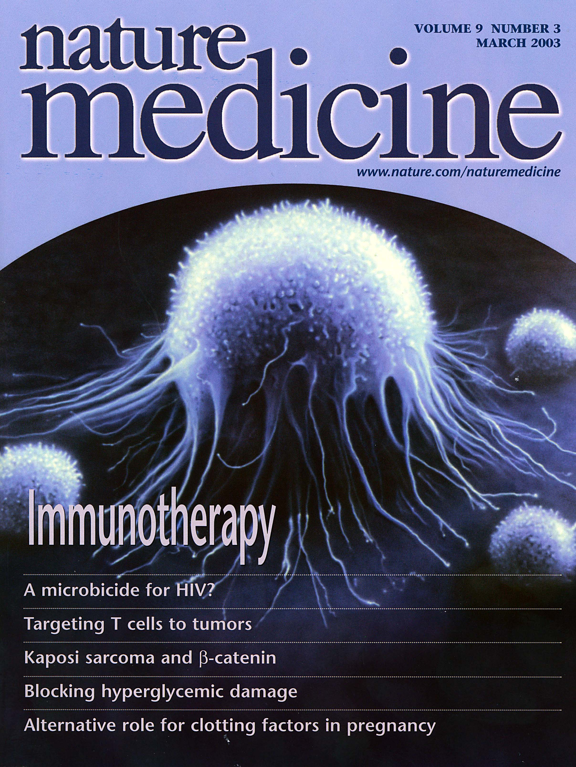
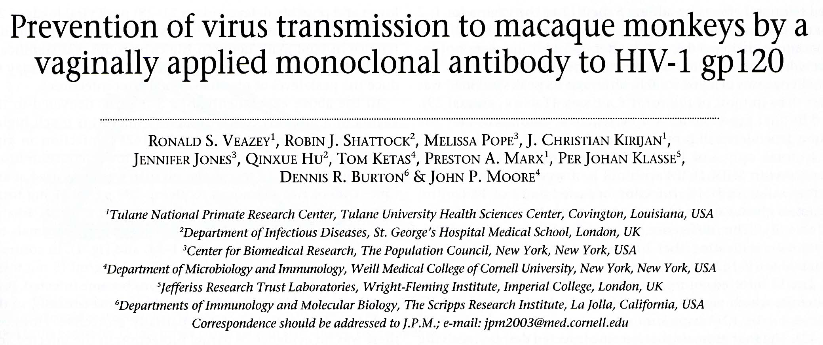

Slide 15
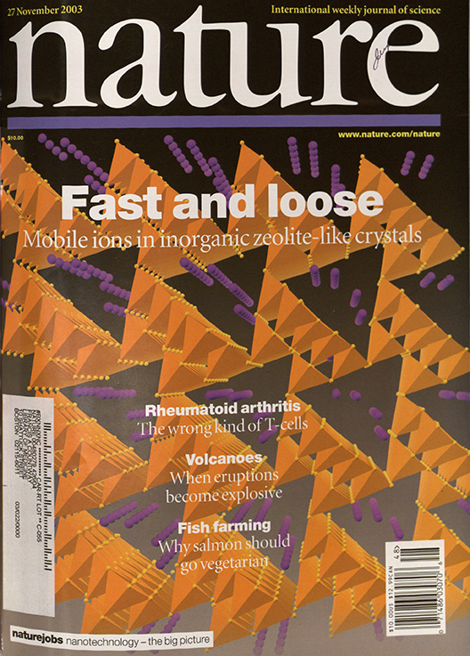
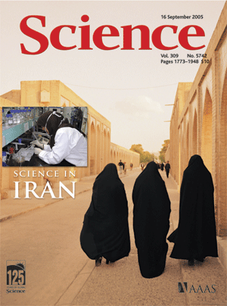
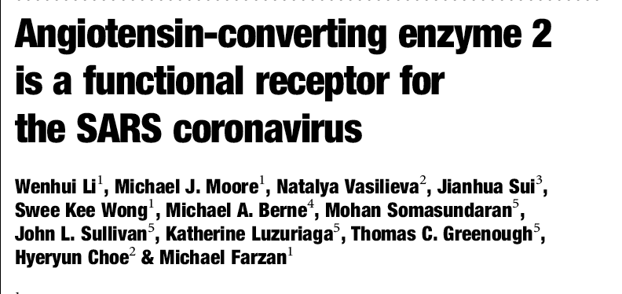

Slide 16
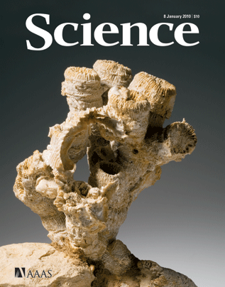

Slide 17
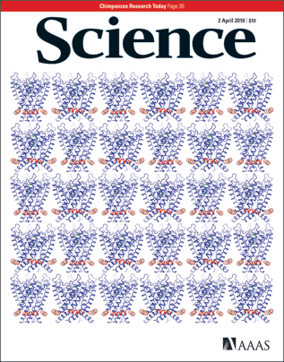

Slide 18
FDA-APPROVED C6 TEST FOR HUMANS

Slide 19
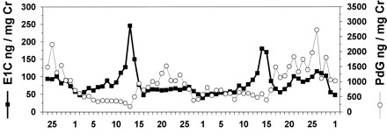
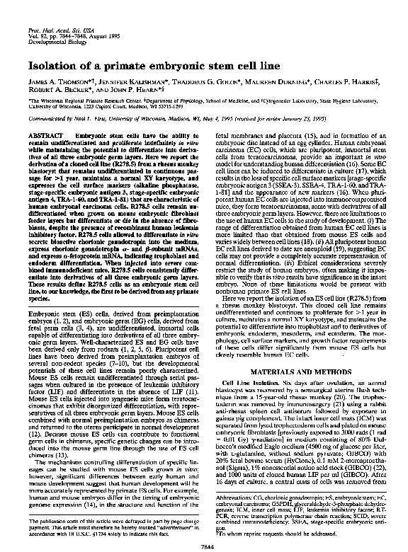
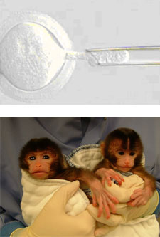
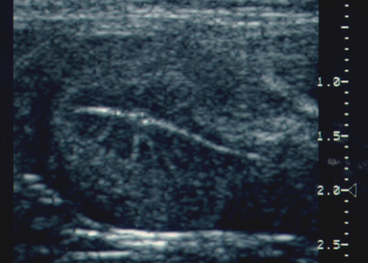
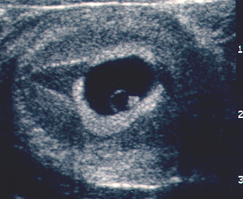
Study of Gametes, Reproduction, Development, and Stem Cell Biology
Menstrual cycle
1995
Early pregnancy
2008
2008
2007
Long history of reproductive research at NPRCs provided the foundation for stem cell research
• Assisted Reproductive Technologies - led to nuclear transfer
• Importance of the model - reproductive and developmental features similar to humans

Slide 20
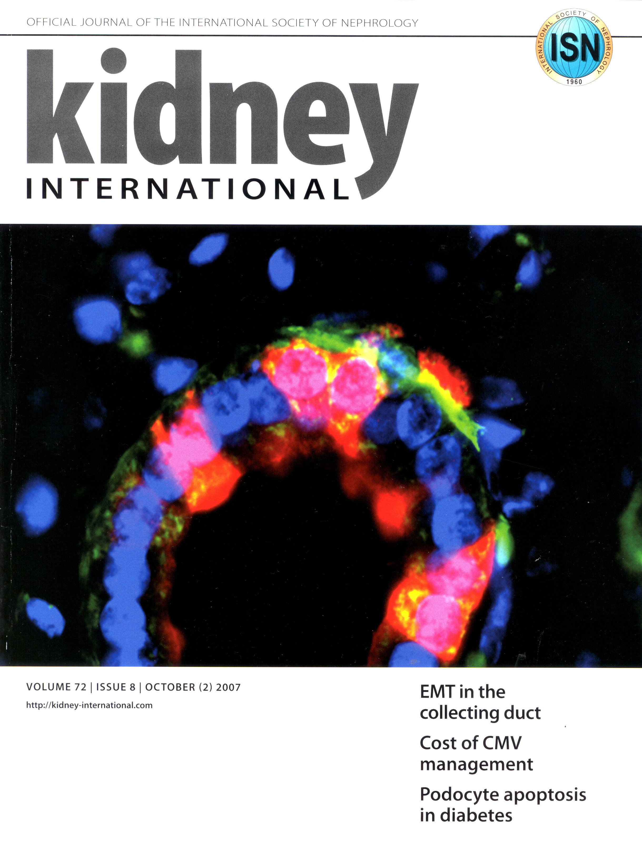
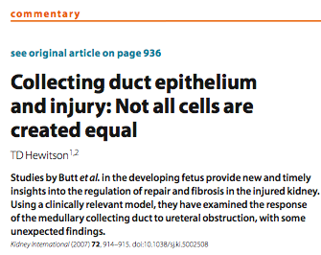
Stem Cell & Regenerative Medicine Research
All major stem / progenitor cell populations are studied at NPRCs:
• Hematopoietic stem (HSC) and progenitor cells
• Mesenchymal stem cells (MSC)
• Endothelial progenitors (EPC)
• Embryonic stem (ES) cells
• Induced pluripotent stem cells (iPS)
• Organ-specific progenitors
2007
Stem Cells
J Cell Biochem
Nature
Science

Slide 21
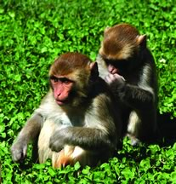
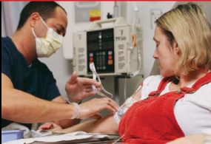
Importance of Nonhuman Primates
for Regenerative Medicine
• Address questions that cannot ethically be assessed in humans nor answered in other species
• Demonstrate safety and efficacy
• Accelerate clinical development of new therapies

Slide 22
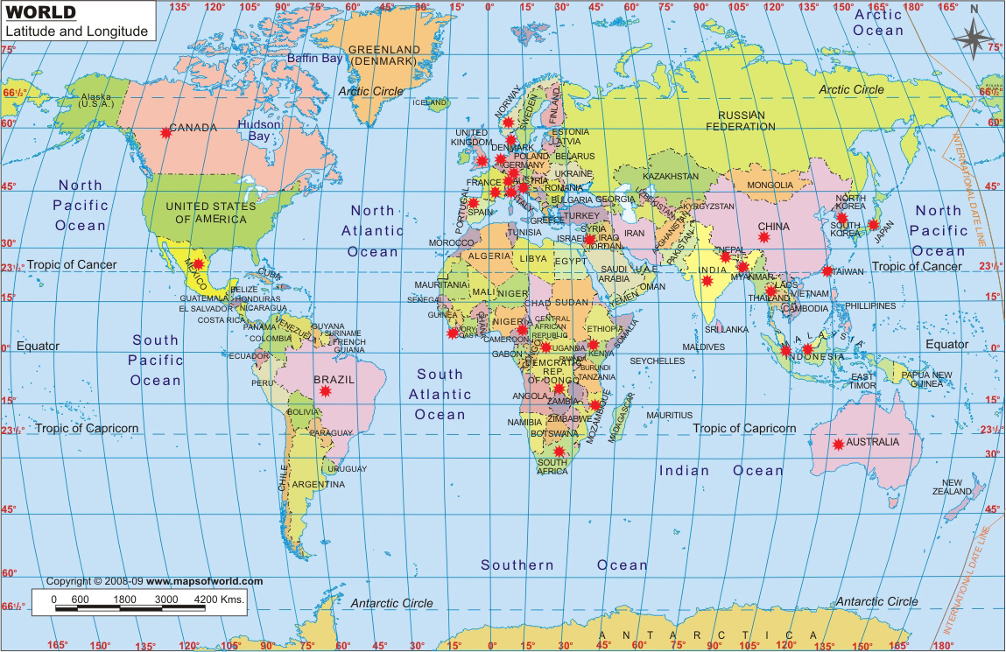
Geographic Distribution of Existing International Collaborations of US NPRCs
32 countries: 10 European countries: 8 EU members

Slide 23
Types of Existing International Collaborations
Research collaborations
Education and Training
Visiting Scientists
Assistance in development of nonhuman primate resources in
China
India
Indonesia
Nepal
Conservation

Slide 24
Opportunities and Obstacles for International Collaboration
Opportunities
Communication, coordination and resource sharing
Bioinformatics
Education and Training
Visiting scientists
Obstacles
Regulatory hurdles
Transporting samples
Funding
for international, multicenter projects
Visiting Scientists and others
Different subspecies (geographic variants) of macaques predominate in US and EU

Slide 25
The eight NPRCs
Dr. David Anderson, Washington NPRC
http://www.wanprc.org/
Dr. Ronald Desrosiers, New England NPRC
http://www.hms.harvard.edu/NEPRC/
Dr. Nancy Haigwood, Oregon NPRC
http://www.ohsu.edu/xd/research/centers-institutes/onprc/
Dr. Dallas Hyde, California NPRC
http://www.cnprc.ucdavis.edu/
Dr. Andrew Lackner, Tulane NPRC
http://www.tnprc.tulane.edu/index.shtml
Dr. John Levine, Wisconsin NPRC
http://www.primate.wisc.edu/
Dr. John VandeBerg, Southwest NPRC
http://www.sfbr.org/SNPRC/index.aspx
Dr. Stuart Zola, Yerkes NPRC
http://www.yerkes.emory.edu/

